Slide 1
Disaster Recovery
Computer Systems Management
Module Code CT012-3-3
Level 3
VD1

Slide 2
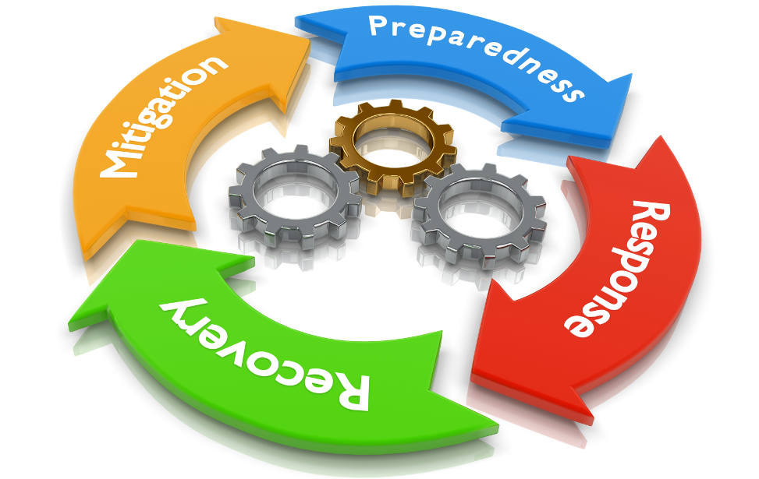
Learning Outcomes
Disaster
Disaster Recovery (DR)
Business Continuity (BC)

Slide 3
Content
Disaster Recovery (DR)
Business Continuity (BC)
Business Continuity Plan (BCP)
Disaster Recovery Plan
Disaster Recovery Plan Elements

Slide 4
Key Terms
Disaster Recovery (DR)
Business Continuity (BC)

Slide 5

Disaster
Disaster - an unexpected event such
as an accident or a natural catastrophe, that causes damage or loss of life
It can be natural, man-made or mechanical e.g. earthquake, flood,
cybercrime,
hard-disk failure

Slide 6


Threat Radius: Impact of a Disaster
Global
Regional
< 400km
Secondary
Data Center
Primary
Data Center
DR Site
Metro
< 50km
In the event of a disaster, it is necessary to move a centralized computing facility to a far-away backup location
Local
1-2 km

Slide 7
Disaster Loss
59% of Fortune 500 companies experience a minimum of 1.6 hours downtime per week. This translates to more than $46 million per year in costs.
Virgin Blue Airlines - check-in and online booking systems went down because of a hardware failure for 11 days. Customers could not board scheduled flights, received negative press, costing millions in profits

Slide 8
Business Continuity (BC)
It is about taking responsibility to
ensure an organization can resume its business operations from any type of disasters or disruptions
Improves resilience by identifying key products and services that must continue in the face of a disaster
Strategy that provides a solid framework in times of crisis for stability and security

Slide 9
Business Continuity Plan (BCP)
BCP includes
  Safeguarding people during a disaster
  Documenting business procedures
  Up-to-date evacuation plans that everyone knows and has practiced
  Alternate workspaces for employees
  Backup IT sites unaffected by the disaster
  Internal and External Resources

Slide 10
Business Continuity Plan
  Internal Resources
  1. Multiple Data Centers (DC)
  Provide emergency backup for critical services
  2. Distributed processing
  Critical processing done locally instead of DC
  Standardize HW & SW at remote locations so that each site is a backup to the other sites
  3. Backup Telecommunication Facilities
      Duplicate communication facilities e.g. routers
      Alternate technologies e.g. leased lines and Internet

Slide 11
Business Continuity Plan
  External Resources
1. DR Firm
Cost Vs. Risk may not justify permanent resources, companies use DR firm services:
  a. Integrated DR services
  Fully operational DC facility
  High speed telecomm lines
  Environmentally suitable storage locations
  Mobile facilities e.g. trailer
  Warehouse space

Slide 12

Business Continuity Plan
  b. Specialized DR services
  Mainframe clients
  Midrange servers
  Network reconfiguration
  Data communications backup programs

Slide 13
Disaster Recovery (DR)
Disaster Recovery - documented procedure to recover, protect a business’ IT infrastructure in the event of a disaster
Includes actions to be taken before, during and after a disaster to recover to an operational state in a short period of time
BC is broader than disaster recovery
DR is a component of business continuity

Slide 14
Importance of Disaster Recovery
Two out of five enterprises that experience a disaster go out of business within five years (Gartner Group)
Protects business asset
Insurance for computer and information systems
Take action before it is too late
Statutory requirement i.e. Law

Slide 15
Backup Locations
Hot Site: Live backup site that is up and running all the time. The production environment is replicated at the Hot Site allowing immediate cutover in case of disaster. A must for mission critical business
Warm Site: Provides many of same services and options of the hot site. Software applications are either not included, not installed or not configured. If disaster strikes software and data must be restored at the Warm Site
Cold Site: Only rudimentary services and facilities e.g. DC space, power, network connectivity. During disaster hardware, data must be moved to Cold Site to resume operations
Notes:
Security and disaster recovery: they are really 2 sides of a coin.
One is how to prevent a problem and the other is how to recover from one.
Granted, security is not the only problem that can create the need for disaster recovery, but it is one of them.
Regardless of cause of disaster or discontinuity of service, you need a strategy for getting the IT services back in place.

Slide 16
Disaster Recovery Plan (DRP)
Successful DR Plan
  Determine vulnerabilities and impact of each possible event
  Determine scenarios most likely to occur
  Determine level of protection required to protect the necessary resources
  Determine the cost/benefit for each level of protection and select accordingly
  Assign resources and implement the plan
  Sell everyone in organisation on value of the plan
  Test/update/audit the plan as often as possible

Slide 17
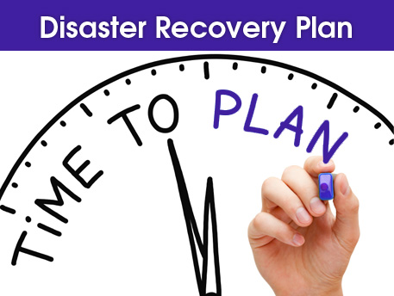
Disaster Recovery Plan (DRP)
Important Features for Level of Protection
  Fault-tolerant systems
  Mirrored disks
  Disk duplexing
  Multiple lines
  Different networks
  Additional devices
  Uninterrupted power supply (UPS)
  Incremental backups

Slide 18
Disaster Recovery Plan Elements
Names of responsible individuals
Staff assignments and responsibilities
List of priorities of “fix-firsts”
Location of alternative facilities
Recovery procedures for data communications facilities, servers and application systems
Actions to be taken under various contingencies
Manual processes
Updating and Testing procedures
Safe storage of data, software and the disaster recovery plan itself

Slide 19
Summary
Question and Answer Session
Disaster - an unexpected event such as an accident or a natural catastrophe, that causes damage or loss of life
Disaster Recovery (DR) - documented procedure to recover, protect a business’ IT infrastructure in the event of a disaster
Business Continuity (BC) - taking responsibility to
ensure an organization can resume its business operations from any type of disasters or disruptions

Slide 20
Review Questions
Question and Answer Session
Explain the meaning of disaster
What is Business Continuity (BC)

Slide 21

Question and Answer Session
Question and Answer Session
Q & A

Slide 22
What We will Cover Next
Question and Answer Session
e-Commerce

